Slide 1
Welcome to Junior Jellies Summer Python Course

Slide 2
We will be learning how to program a computer
**Coding**

Slide 3
We will be learning two languages
Scratch
Python

Slide 4
“But Scratch is not a programming language”
- Everyone
Yes we understand. But in order to learn Python, it is really important to learn the building blocks of all programming language. Scratch makes this really easy to visualize the building blocks.

Slide 5
Let’s get started
https://scratch.mit.edu

Slide 6
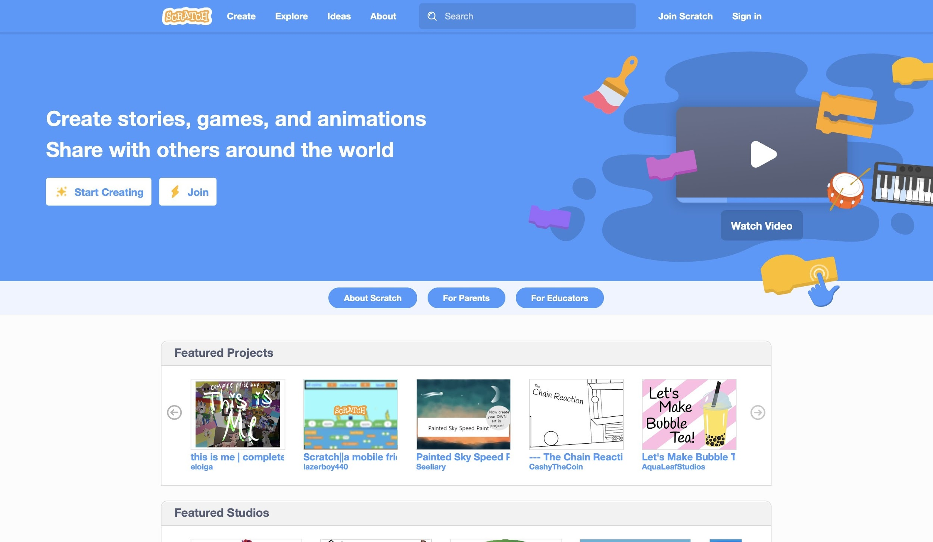
there
Click

Slide 7
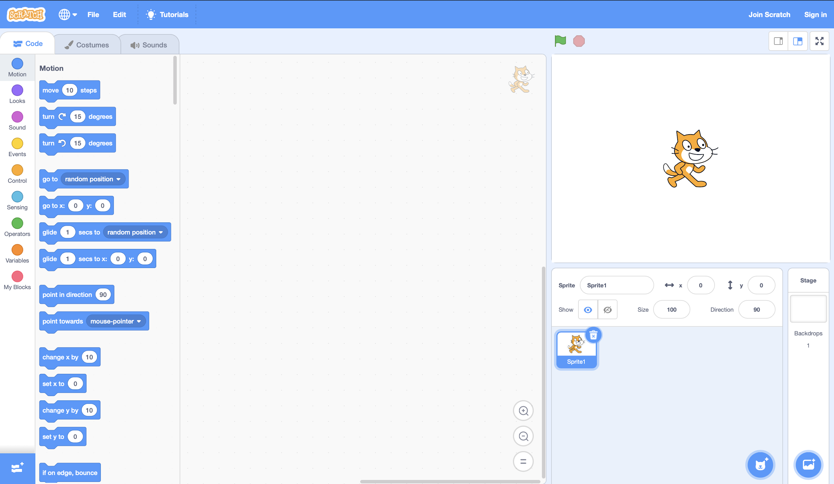
Where you will access the blocks
Where you will write your program
Where you will test your program

Slide 8
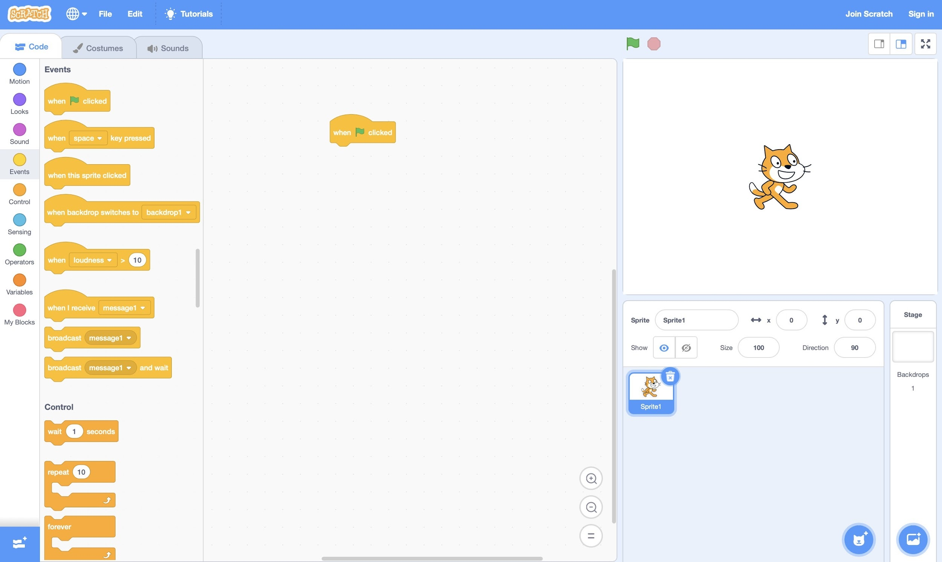
Drag this block
Click
here
first

Slide 9
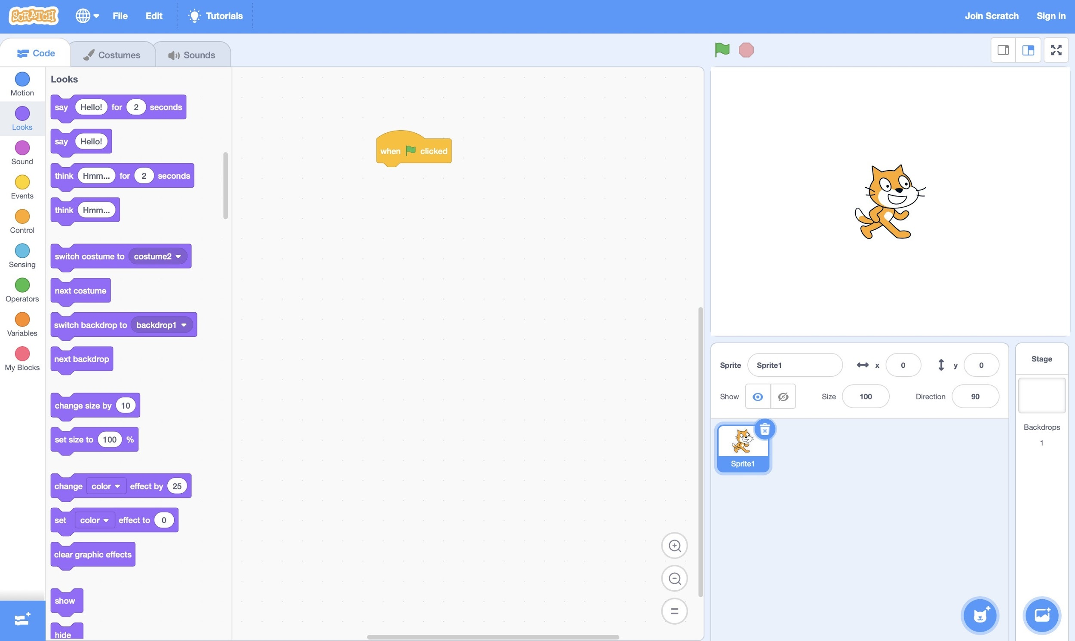
Click here

Slide 10
Demo
How do we make the cat say
“Hello, World”

Slide 11
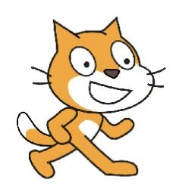
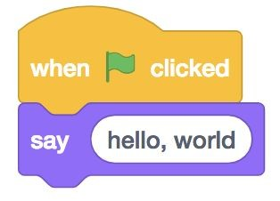
Hello, World

Slide 12
Demo
Now how do you make the cat ask for your name and then say your name?

Slide 13
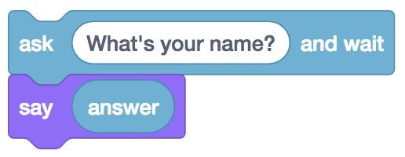
Bob
If you are having a hard time looking for these blocks, use the color to help you

Slide 14
Demo
How do you make the cat say
“Hello,” and your name?

Slide 15
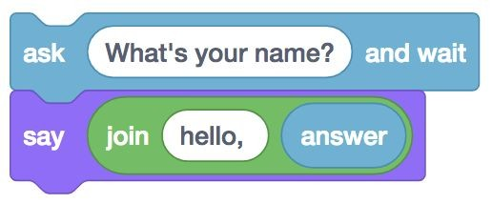
hello, Bryant

Slide 16
Demo
Now, try to make
the cat say
“hello, world” fifty times?

Slide 17
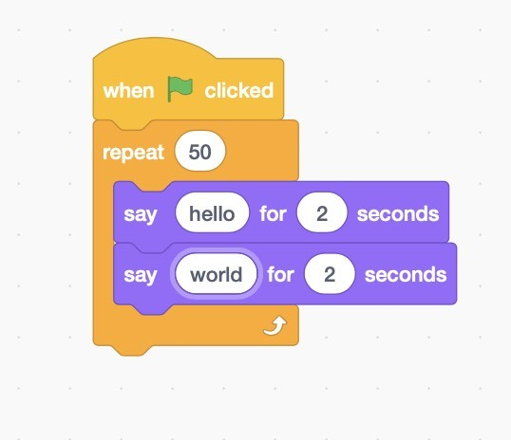
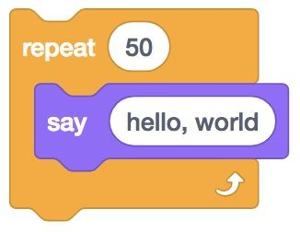
hello, world (repeats 50 times)

Slide 18

Introduction to variables
Imagine you have
a box

Slide 19
That box can only hold one
value. That value can be any
word or a number
1
Apple

Slide 20

You also have to give each box a name.
1
Apple
Number box
Letter box

Slide 21
The box can change the value that it holds too
500
Jellyfish
Number box
Letter box

Slide 22
Sometimes, the box can be empty
Number box
Letter box

Slide 23
This box that you just learned
is called a variable.
A variable is a thing that can hold a value.
(just like a box)

Slide 24
Demo
Let’s make a variable called “counter” and set it equal to 0

Slide 25

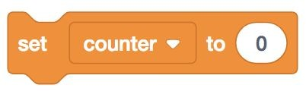
0
Counter

Slide 26
Demo
Now let’s change the value of
“counter” by taking the value of “counter“ and adding 1

Slide 27
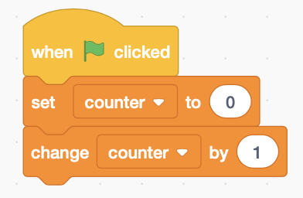
0+1
Counter

Slide 28
What is the new value of counter?

Slide 29
1
1
Counter

Slide 30
Let’s do it again

Slide 31
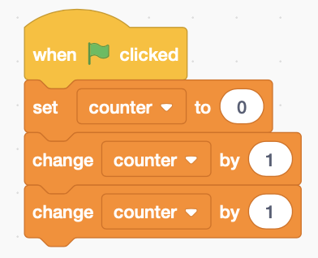
1+1
Counter

Slide 32
What is the new value of counter?

Slide 33
2
2
Counter

Slide 34
Demo
How do we make the cat say
“Counter is equal to 1” when the variable counter is equal to 1?

Slide 35
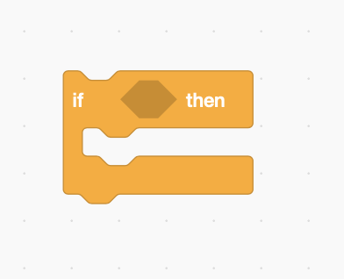

Slide 36
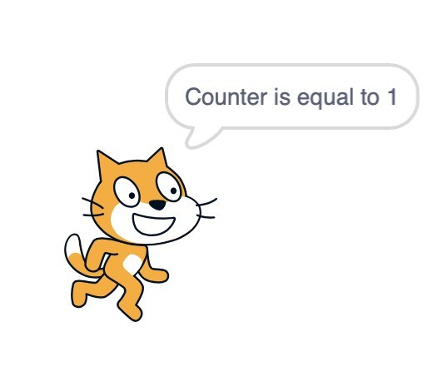
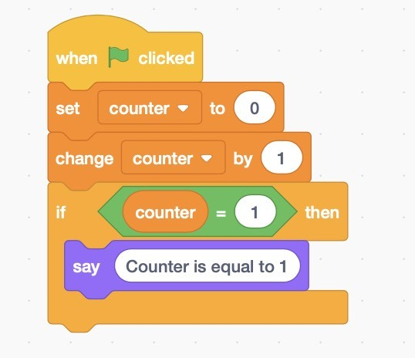

Slide 37
Demo
What if we want the cat to say “Counter is equal to 1” when counter is equal to 1?
Otherwise, say “Counter is not equal to 1.”

Slide 38
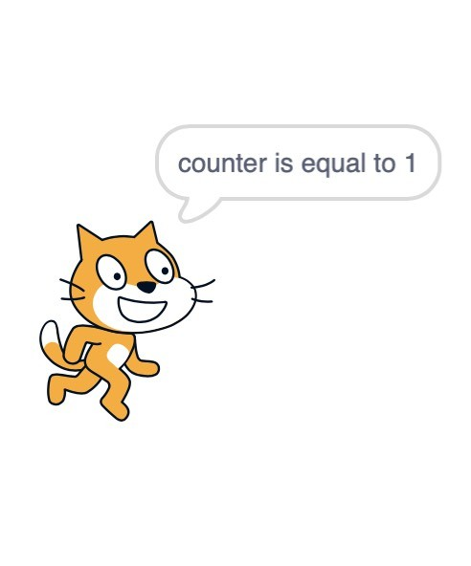
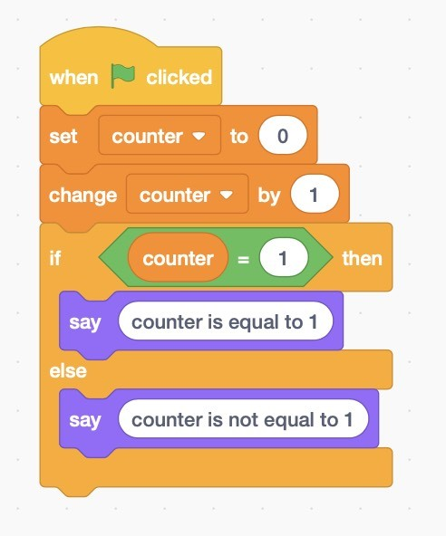

Slide 39
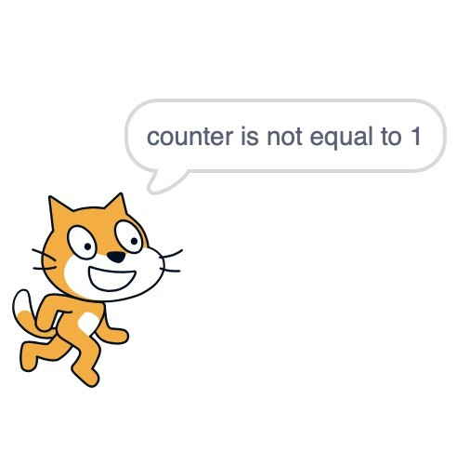
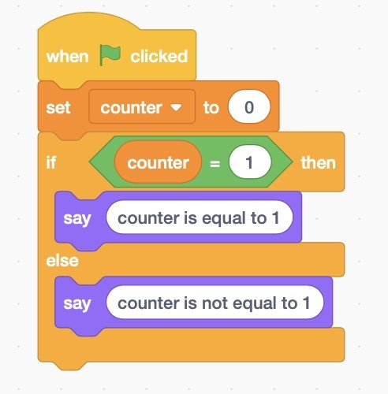

Slide 40
Demo
What if we want the program to say:
If counter is equal to 1:
Make the cat say “counter is equal to 1”
Else if counter is equal to 2:
Make the cat say “counter is equal to 2”
Else:
Make the cat say “counter is not equal to 1 or 2”

Slide 41
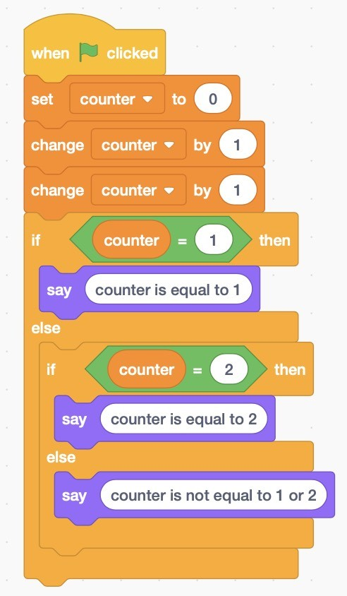
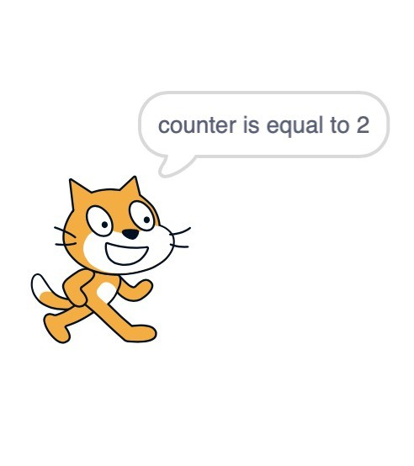

Slide 42
Let’s do another example.
If counter is equal to 0:
make the cat say (“counter is equal to 0”)
Else if counter is equal to 5:
make the cat say (“counter is equal to 5”)
Else:
make cat say (“counter is not equal to 0 or five”)

Slide 43
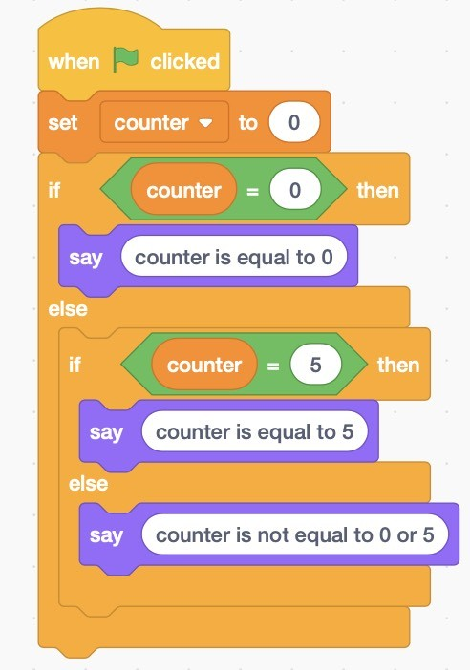
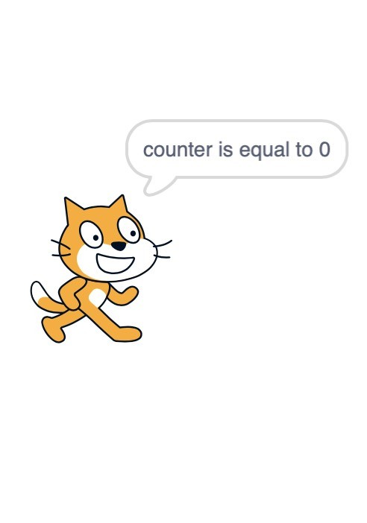

Slide 44
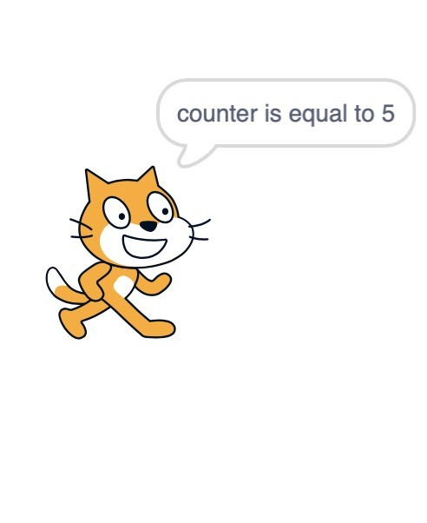
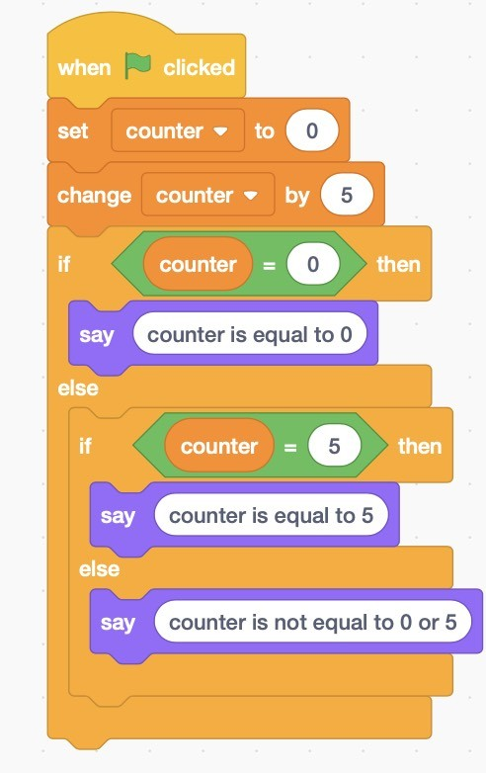

Slide 45
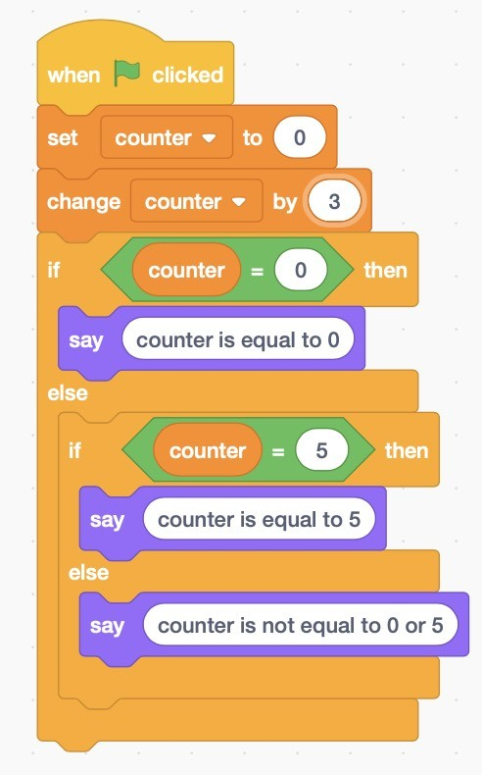
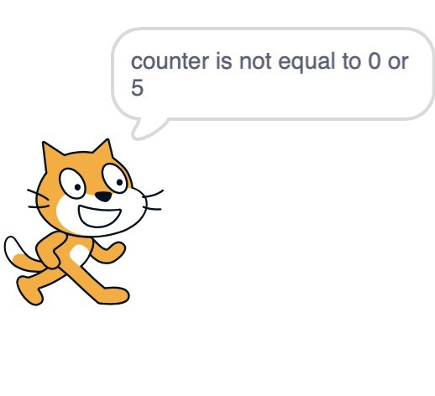

Slide 46
Write your own program that has a variable and and if statement.
Send it to one of the advisors when you are done
If you are not sure what to do, you can try using the examples that we did before with different numbers.

